Slide 1




Notes:
“Eyewitness News” – News organizations like to emphasis that their news and information originates from reliable sources, such as eyewitness testimony, not on hear say, in other words, its not fake news. They want you to believe that their news is reliable and has been confirmed by trustworthy sources. So it is with authors of the Word of God. The Apostle Peter had reported and proclaimed that the crucified and resurrected Jesus Christ was coming again with power and glory, to judge living and the dead. But some “scoffers” were claiming this was all fake news, nothing but “cunningly devised fables”. So just relax and enjoy yourself, the world is not coming to an end.

Slide 2

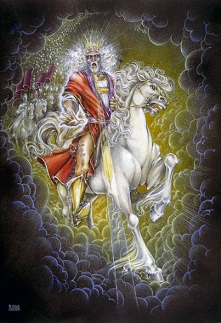
Growing in Holiness
2 PETER
The Blessed Hope is the certainty that our God and Savior Jesus Christ is retuning soon, just as He promised to rescue us before the Day of the Lord, and at the very end, the world is going to burn. In light of this Peter tells us how we should then live.
Notes:
Peter reported that this present world is coming to an end, in fact, the end of all things is near, therefore we all should act accordingly.
The Blessed Hope is the certainty that our God and Savior Jesus Christ is retuning soon, just as He promised to rescue us—those who have believe in Him--before the Day of the Lord comes. At the end of all things the present created world and heaven is going to dissolve away in a great ball of fire and with a mighty roar.
This is the blessed hope is the certainty that our God and Savior Jesus Christ is returning. Today Peter is going to tell us that this is no fairy tale. In fact His coming with power and glory is based on eyewitness testimony of what he and his fellow Apostle both saw and heard. And it is confirmed by God the Father and the by the Holy Spirit.

Slide 3
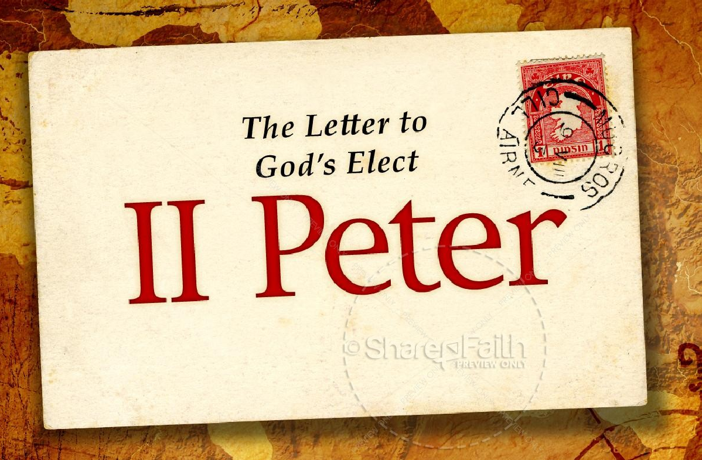
Growing in Holiness
in Light of the Promised Blessed Hope of the Lord and Savior’s Soon Return
Notes:
The theme of Second Peter is…

Slide 4

Growing in Holiness
2 PETER
Key Verse:
“Therefore, since all these things will be dissolved, what manner of persons ought you to be in holy conduct and godliness” (2 Peter 3:11)
Notes:
“Therefore, since—it is certain that--all these things (the heaven, the elements, the earth and the works that are in it) will be dissolved (loosen), what manner of persons ought you to be in holy conduct and godliness” (2 Peter 3:11)

Slide 5
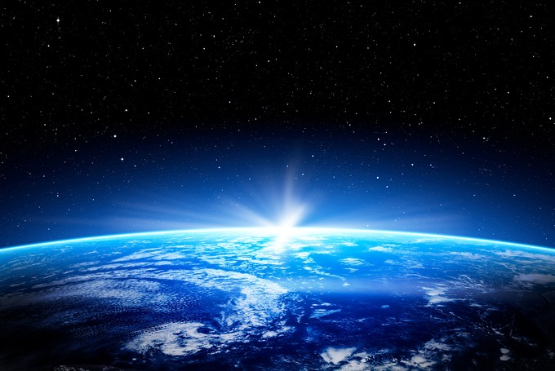
Growing in Holiness
2 PETER
A Verse of Hope:
“Nevertheless we, according to His promise, look for new heavens and a new earth in which righteousness dwell” (2 Peter 3:13)
Notes:
We do not have to fear the apocalypse, “the end of the world”. Nor do we have to leave our planet and move to the heavens, but heaven is going to come down to us and make all things new. Peter has already seen the future. He has already seen heaven coming down. Peter does not preach a pessimistic message of doom and gloom, but teaches a lesson of light appearing out of darkness, from doom to bloom.

Slide 6
2 Peter 1:16-21
Notes:
“For we did not follow cunningly devised fables when we made known to you the power and coming of our Lord Jesus Christ, but were eyewitnesses of His majesty. For He received from God the Father honor and glory when such a voice came to Him from the Excellent Glory: "This is My beloved Son, in whom I am well pleased." And we heard this voice which came from heaven when we were with Him on the holy mountain.
And so we have the prophetic word confirmed, which you do well to heed as a light that shines in a dark place, until the day dawns and the morning star rises in your hearts; knowing this first, that no prophecy of Scripture is of any private interpretation, for prophecy never came by the will of man, but holy men of God spoke as they were moved by the Holy Spirit.”

Slide 7

Growing in Holiness
2 PETER
The Prologue of the Letter – 1:3-11
The Basis of Holiness – 1:3-4
Notes:
We have seen and heard already that Peter is concerned about the moral character of his flock and the dangers that threaten them. He first reminds them of the basis of their holiness, the gracious provision of power and promises that God has provided for their growth in holiness (vs. 3-4) which are the foundational reason why we should follow through and add to our faith.

Slide 8
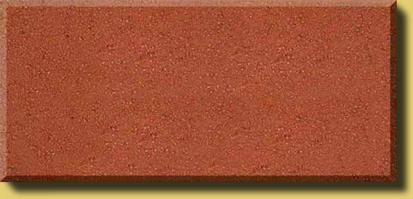
Growing in Holiness
2 PETER
The Prologue of the Letter – 1:3-11
The Basis of Holiness – 1:3-4
PARTAKE
POWER
PROMISE
KNOWLEDGE BASED FATIH
GOD’S GLORY AND VIRTUE
Notes:
Its because of God’s Person, His glory, His moral excellence, holiness and His love for us, that makes everything possible. It is the deepest foundation in whom we trust.
God’s is love, it is the reason that He loved the world and sent His Son as the provision for our salvation. Our faith is based in the knowledge of Christ’s person and provision and proclamation. It is by the means of our faith in Christ’s person and His provision that was proclaimed to us, that we received eternal life.
Our faith in Christ is also the means by which we are now made recipients of a spiritual equipping and empowering. It is knowledge based faith in Christ that is the means by which we can also now access God’s power and promises.
It is God’s divine power that has sufficiently gifted us with all things related to life and godliness. We have all that they could possible need to live a godly life. Nothing else is needed.
God has also given us “exceedingly great and precious promises.” Of course the first promise is the promise of eternal life, for all who believing in Christ. In Peter’s second letter the promises that he has most in mind are the promises that God has given us in order that we live godly in this life. And these promises, along with his power, are also the means by which we can become partakers of God’s nature.
Peter also has in mind the future prophetic promises of the coming of the Lord Jesus Christ. Including the promise of His physical bodily coming in the future with power and glory to establish the kingdom of God on earth. Peter, along with his fellow disciples, James and John, have already seen this coming. But when Jesus comes at the end of the age, at that time every eye on earth will see Him. This is the “apocalypse”--the revelation, the unveiling or uncovering of the Lord Jesus Christ which will bring an end to that age, the Mosaic age. The Mosaic age did not end in AD 70, but it is yet to be concluded. After the conclusion of the Mosaic age and Daniel’s 70th seven, Christ will begin his reign on earth for 1000 years.
Then after the 1000 years the promise of a new heaven and earth in which only righteousness dwells, where there will no sin, will be fulfilled. God will “wipe away every tear from our eyes; there shall be no more death, nor sorrow, nor crying. There shall be no more pain, for the former things have passed.” (Rev. 21:4) This is the completion of all things. We now live in anticipation of all these things.
In order for us to maintain a holy life in a corrupt world like ours, we must be deeply fixed in these prophetic promises of God’s word. We must hold fast/stand in the “blessed hope” of the return of our Lord and Savior Jesus Christ. Failing to do so only leads to fear and to an absence of readiness. The absence of readiness then leads to a loss of future rewards, praise, honor, and glory.
He first reminds them of the basis of their holiness, which are the foundational reason why we should follow through and add to our faith. Next…
.

Slide 9
Growing in Holiness
2 PETER
LOVE
The Basics of Holiness – 1:5-11
The Characteristics
of Holiness – 1:5-7
BRO. KINDNESS
GODLINESS
PERSEVERANCE
The Consequences
of Holiness – 1:8-9
SELF CONTROL
KNOWLEDGE
The Conclusiveness of Holiness – 1:10-11
VIRTUE
FAITH
Notes:
He first reminds them of the basis of their holiness, which are the foundational reason why we should follow through and add to our faith. Next Peter describes the basics of holiness, beginning with the basic characteristics of holiness…
Secondly, Peter describes the basic consequences of holiness in verses 8-9. He first states the case positively, that if these qualities are diligently pursued it will produce active, fruitful Christians and he states the case negatively that those who fail to diligently pursue these attributes leads to a blind and shortsighted life which God’s past grace is seemly forgotten. Producing an active, fruitful life now is the first reason that moral development is to motivate diligence in spiritual growth.
Thirdly Peter describes the basic inevitable results of holiness (10-11), which is the second reason these traits should motivate us to increased diligence. These results are of a broader scope. For these results include a verification of our calling and election to service and a rich entrance into the coming kingdom of God.

Slide 10
Growing in Holiness
2 PETER
LOVE
Basis
BRO. KINDNESS
Power and Promises
GODLINESS
PERSEVERANCE
Personal Results -
Positive and Negative
SELF CONTROL
KNOWLEDGE
VIRTUE
Proof and Praise
FAITH
Notes:
So far, “Peter has thus far argued for the moral development presented (5-7) on the basis of (1) God’s gracious powerful and promised provisions for Christian living (3-4), and on the basis of personal results, both positive and negative, that the presence or the absence of these traits produce (8-9).” [Hodges, p. 27]
Lastly Peter argues that these traits of moral development (5-7) should motivate us to increased diligence. For these results (10-11) include Proof of our calling and choosing for service, and plentiful Praise before all those under heaven.

Slide 11

Growing in Holiness
2 PETER
The Purpose of the Letter – 1:12-15
To Establish Them in the Present Truth
Notes:
After the introduction, (3-11), the Peter discloses his purpose in writing this letter in verses 12-15. His purpose is that his readers stand firm and to establish them in the present truth.
That truth includes the certainty of Christ return--the promise of His Coming. This promise, is, has and will, come under attack from “scoffers” (3:3-4) who deny Christ physical return. The remainder of the epistle is basically a defense of the godly lifestyle to which the great promise concerning the end of all things motivates us (3:11-13). The “scoffers” in turn are condemned for their unbelief and skepticism. The “scoffers” are also condemned for their immoral lifestyle, which is a direct result of their denial of Christ’s coming in judgment.
In this brief section of the letter (1:12-15) Peter reinforces the immediate truth his readers already possess and encourages them to stand firm and not be moved from their present position, but the danger always exists that they could fall into error.

Slide 12
Growing in Holiness
2 PETER
The Body of the Letter – 1:16 – 3:13
To Establish Them in the Present Truth
Notes:
Now we come to the main body of the letter in which Peter is going to strongly encourage his readers to hold fast to the hope of Christ’s coming.

Slide 13
Growing in Holiness
2 PETER
The Body of the Letter – 1:16 – 3:13
The Hope of Christ’s Coming…
is a Certainty – 1:16-21
will Encounter Opposition – 2:1 - 3:9
will Culminate in the Day of the Lord – 3:10-13
Notes:
They need to hold fast because His coming is first of all a certainty. Secondly they need to hold fast in spite of opposition and last because the Day is coming, the Day of the Lord that is, which could be any day now.

Slide 14
Growing in Holiness
2 PETER
The Body of the Letter – 1:16 – 3:13
The Hope of Christ’s Coming…
is a Certainty [Based on] – 1:16-21
Reliable Eyewitness Testimony – 1:16-18
Confirmation by the Spirit of God – 1:19-21

Slide 15
Growing in Holiness
2 PETER
The Hope of Christ’s Coming is a Certainty Based on
Reliable Eyewitness Testimony
1:16-18
Hold Fast to the Hope of Christ’s Coming

Slide 16
Growing in Holiness
2 PETER
Reliable Eyewitness Testimony
“For we did not follow cunningly devised fables when we made known to you the power and coming of our Lord Jesus Christ, but were eyewitnesses of His majesty.” (1:16)
Hold Fast to the Hope of Christ’s Coming
Notes:
“Peter opens the main section of his epistle by giving the reason why he should do the kind of reminding that he has spoken about in verses 12-15. These matters are worth the effort because “for” they are true.” [Hodges, p. 42] However, not everyone believes they are true, but say that the stories of the coming of the Lord Jesus Christ in power and glory is a mere “cunningly devised fables”. Peter must of heard this time and time again, from the “scoffers” (3:3-4) that the doctrine of the Second Coming was merely a shrewdly designed “myth”. The word rendered “fables” is a form of the Greek noun “muthos” from which we get the word in English from the Latin “myth” Fables are fairy tales, make believe stuff.
Peter says, “Not, so”, “No, way!” He declares and instead doubles down that he and his fellow apostles (James and John) were eyewitnesses of Christ’s future “majesty” when—at the transfiguration—they were allowed to see and behold Christ’s power and coming in glory. What was on display was the mighty splendor of the King of Glory.
What they saw was not a preview, but a vision of the future Lord’s coming in power at His transfiguration -- ”metamorphoo”– “metamorphous”…

Slide 17
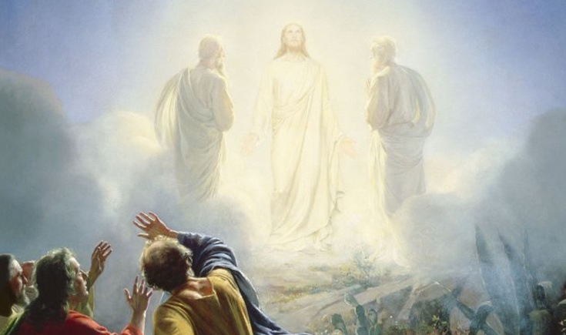
Growing in Holiness
2 PETER
Reliable Eyewitness Testimony
The Transfiguration of Jesus
Notes:
The three apostles (Peter, James and John) saw on the Mount of Transfiguration was the Son of Man coming in His Kingdom—the Kingdom of God present with power—or simply the kingdom of God!” They saw in the present, the future coming of the King in power.
We should note the remarks that precede each of the Transfiguration accounts in the first three Gospels. They are as follows…

Slide 18
Growing in Holiness
2 PETER
Reliable Eyewitness Testimony
“…For the Son of Man will come in the glory of His Father with His angels, and then He will reward each according to his works. Assuredly, I say to you, there are some standing here who shall not taste death till they see the Son of Man coming in His kingdom.” (Matt. 16:27-28; The Transfiguration follows 17:1-8)

Slide 19
Growing in Holiness
2 PETER
Reliable Eyewitness Testimony
“…And He said to them, ‘Assuredly, I say to you that there are some standing here who will not taste death till they see the kingdom of God present with power.” (Mark 9:1; The Transfiguration follows 9:2-8)

Slide 20
Growing in Holiness
2 PETER
Reliable Eyewitness Testimony
“But I tell you truly, there are some standing here who shall not taste death till they see the kingdom of God.” (Luke 9:27; The Transfiguration follows 9:28-36)
Notes:
It seems at least clear that two are directly connected—that some of Jesus’s disciples, but not all were going to see an unveiled Jesus, who was the Son of Man coming with power in His future Kingdom.

Slide 21
Growing in Holiness
2 PETER
Reliable Eyewitness Testimony
“Now after six days Jesus took Peter, James, and John, and led them up on a high mountain apart by themselves; and He was transfigured before them. His clothes became shining, exceedingly white, like snow, such as no launderer on earth can whiten them. And Elijah appeared to them with Moses, and they were talking with Jesus…”
Notes:
Mark’s Gospel tells Peter’s account of this event and says, “Now after six days Jesus took Peter, James, and John, and led them up on a high mountain apart by themselves; and He was transfigured before them. His clothes became shining, exceedingly white, like snow, such as no launderer on earth can whiten them. And Elijah appeared to them with Moses, and they were talking with Jesus…” (Mark 9:2-3)

Slide 22
Growing in Holiness
2 PETER
Reliable Eyewitness Testimony
“Then Peter answered and said to Jesus, ‘Rabbi, it is good for us to be here; and let us make three tabernacles: one for You, one for Moses, and one for Elijah" — because he did not know what to say, for they were greatly afraid.”
Notes:
“Then Peter answered and said to Jesus, ‘Rabbi, it is good for us to be here; and let us make three tabernacles: one for You, one for Moses, and one for Elijah" — because he did not know what to say, for they were greatly afraid.” (Mark 9:4-6)

Slide 23
Growing in Holiness
2 PETER
Reliable Eyewitness Testimony
“…And a cloud came and overshadowed them; and a voice came out of the cloud, saying, "This is My beloved Son. Hear Him!“ Suddenly, when they had looked around, they saw no one anymore, but only Jesus with themselves.”
(Mark 9:2-8)
Notes:
“And a cloud came and overshadowed them; and a voice came out of the cloud, saying, "This is My beloved Son. Hear Him!" Suddenly, when they had looked around, they saw no one anymore, but only Jesus with themselves. (Mark 9:7-8)

Slide 24
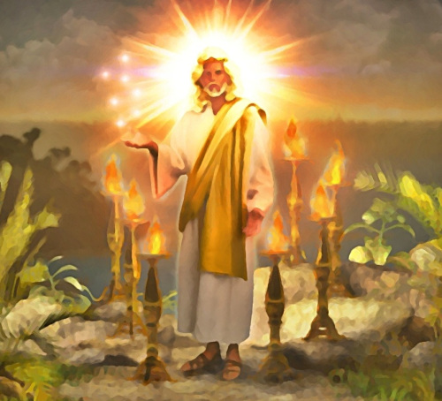
Growing in Holiness
2 PETER
Reliable Eyewitness Testimony
Revelation 1:10-17
Notes:
Later, the apostle John would see Jesus in all His majesty as He presently appeared in heaven.
“I was in the Spirit on the Lord's Day, and I heard behind me a loud voice, as of a trumpet, saying, "I am the Alpha and the Omega, the First and the Last," and, "What you see, write in a book and send it to the seven churches which are in Asia: to Ephesus, to Smyrna, to Pergamos, to Thyatira, to Sardis, to Philadelphia, and to Laodicea.’
“Then I turned to see the voice that spoke with me. And having turned I saw seven golden lampstands, and in the midst of the seven lampstands One like the Son of Man, clothed with a garment down to the feet and girded about the chest with a golden band. His head and hair were white like wool, as white as snow, and His eyes like a flame of fire; His feet were like fine brass, as if refined in a furnace, and His voice as the sound of many waters; He had in His right hand seven stars, out of His mouth went a sharp two-edged sword, and His countenance was like the sun shining in its strength.” (Rev. 1:10-17)

Slide 25
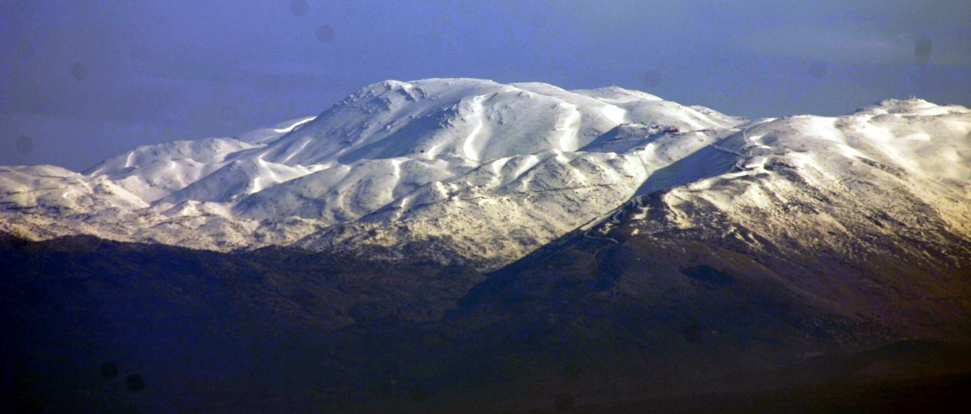
Growing in Holiness
2 PETER
Reliable Eyewitness Testimony
Mount Hermon
Hold Fast to the Hope of Christ’s Coming
Notes:
What the Apostle saw presently on the Mount of transfiguration was a vision of the future Lord’s coming in power and glory. Does this mean that the Kingdom of God is presently here or is the Kingdom of God still future? Many say, yes! The Kingdom of God is still future, but many also say that the Kingdom is already here. The Kingdom of God is often describe as “here, but not yet” or “Inaugurated Eschatology”. Zane Hodges suggest that Jesus clearly taught that the kingdom is here by sighting Luke 17:20-21…

Slide 26
Growing in Holiness
2 PETER
Reliable Eyewitness Testimony
“Now when He was asked by the Pharisees when the kingdom of God would come, He answered them and said, "The kingdom of God does not come with observation; nor will they say, 'See here!' or 'See there!' For indeed, the kingdom of God is within you.” (Luke 17:20-21)
Notes:
The most natural reading of the KJV and NKJV “within you” would be “among you” or NASB “in your midst”. Jesus would not of told the Pharisees that the Kingdom of God was in them, of all people, but it was near and available to them. Hodges concludes that in a very real sense the Transfiguration records the coming of God’s Kingdom into this world secretly, that is, “without observation”, and the three apostolic witnesses were not allowed to make it known until after the resurrection (Mt. 17:9; Mark 9:9; Luke 9:36).
This present form of the kingdom is what many call “the mystery form” of the Kingdom of God that exist in the present (church) age, in which the parables of Matthew 13 fit.

Slide 27
Growing in Holiness
2 PETER
Reliable Eyewitness Testimony
“He has delivered us from the power of darkness and conveyed us into the kingdom of the Son of His love...” (Colossians 1:13)
Hold Fast to the Hope of Christ’s Coming
Notes:
Hodges also says in the same way, Paul declares in Col. 1:13 that the “He, the Father, has delivered us from the power of darkness and conveyed us into the kingdom of the Son of His love,” He points out that Paul does not say “will convey”, but rather “has…conveyed”. We are already in God’s Kingdom here on earth. However…
“We may conclude that at the present time a restricted and invisible form of the Kingdom of God is already in this world… restricted because not all men are as yet its subjects. Believers are already within this kingdom by virtue of their salvation (Col. 1:13) and the Lord Jesus is truly their King. But… the future kingdom is God’s universal kingdom when the Lord Jesus Christ will be visible upon the upon the throne of David (Luke 1:30-31) on the earth when He will ‘rule all nations with a rod of iron’ (Rev. 12:5)” [Hodges, p. 43-44]

Slide 28
Growing in Holiness
2 PETER
Christian Eschatology
Realized Eschatology – “Already”
Historical Eschatology – “Now”
Inaugurated Eschatology – “Already, Not Yet”
Anticipated Eschatology – “Not Yet”
Hold Fast to the Hope of Christ’s Coming

Slide 29
Growing in Holiness
2 PETER
Obtained the Right to Rule
Satan Defeated But
Continues to Rule
Begins His Rule
[Preparing to Rule]
Election
Inauguration
Anticipated Eschatology – “Not Yet”
Hold Fast to the Hope of Christ’s Coming
Notes:
At the cross Christ obtain victory over sin and death and also obtain the right to rule. He won the election. Satan, the current ruler of this world was defeated. But yet just like the president does not actually begin his presidency until he is inaugurated, Christ who has the right to rule is waiting and anticipating the time when He will actually rule. The election has been won! His right to rule has been secured and certified by His death and resurrection. Satan, though, continues to rule the earth and will not give it up without a fight. There will be no peaceful transition of power.
Christ is preparing and waiting in heaven, at the right hand of the Father. The church is also preparing and waiting. We are anticipating the rule of Christ. We now live not so much in some mysterious form of the kingdom of God, but an anticipated form of the future coming Kingdom of God, that is certain to come. The mystery form of kingdom which the parables of Matthew 13 describe is not a new form of the kingdom of God but a new age, new dispensation, a different type of rule of God not previously revealed in which both good and evil coexist, which is not so in the kingdom.

Slide 30
Growing in Holiness
2 PETER
Reliable Eyewitness Testimony
“For we did not follow cunningly devised fables when we made known to you the power and coming of our Lord Jesus Christ, but were eyewitnesses of His majesty.” (1:16)
Hold Fast to the Hope of Christ’s Coming
Notes:
Jesus showed His power in the vision of His coming to the three disciples (and to Moses and Elijah) who were present with Him on the high mountain, but in a future day His power will be manifested to all mankind, when humanity “will see the Son of Man coming in the clouds with great power and glory” (Mark 13:26). At that time every eye will see Him.

Slide 31
Growing in Holiness
2 PETER
Reliable Eyewitness Testimony
“For He received from God the Father honor and glory when such a voice came to Him from the Excellent Glory: "This is My beloved Son, in whom I am well pleased.” (1:17)
Hold Fast to the Hope of Christ’s Coming
Notes:
In addition to His coming power and majesty being made known, the Lord Jesus Christ received honor and glory that accompanied the transfiguration by a voice from God the Father Himself.
Honor and glory are closely related, but can be distinguish. Glory is external and visible, but honor is abstract and unknown until it is revealed. Glory is a quality that belongs to God and is shared by Christ. A quality that we can share in as well. “Honor is the recognition of someone who has attained a position through labors and achievements.. Jesus received honor and glory from the Father, describing the Father as “the Excellent Glory”.
The Excellent Glory refers to the “bright cloud” that “overshadowed” Jesus and His disciples, out of which the came the divine voice (Mt. 17:5). This would be the same cloud as the Shekinah glory which in OT times, represented the glorious presence of God. This cloud became visible at the inauguration of the Tabernacle and at the dedication of Solomon’s temple (Exod. 40:34-35; I Kings 8:10-11)
The voice of God is brought to Jesus by “the Excellent Glory”. The voice did not simply come from heaven, but God the father personally came down from heaven in His glorious cloud and spoke regarding His Son. This adds to the greatness of the tribute which God’s gives to His Son. “This is My beloved Son, in whom I am well pleased”.
We should not overlook the occasion when these words were spoken, that is, at His Transfiguration, revealing His coming in power at the time He will begin His reign as the King of Kings. The words are spoken as a reminder the Jesus is worthy to reign precisely because He did all that God desired and required Him to do, above all going to the cross (a fact alluded to in Luke 9:30-31). The Lord obtained His throne because He pleased His Father so well. The throne, the right to rule, was the joy that enabled Jesus to endure the cross, despising the shame, that made it then possible for Him to sit down at the right hand of the throne of God. (Heb. 12:2).
Also we should not overlook the context with which these words are spoken. Peter readers have just been told to diligently pursue godly character, in order that they may obtain a rich entrance into the “everlasting kingdom of our Lord Jesus Christ” (1:11). The clear implication is for his readers and us should be to seek to be well-pleasing to God so that when Jesus comes into His Kingdom, they may also share in His kingly glory.
Peter had previously told His readers that if they endure various trials they too will obtain praise, honor, and glory at the revelation of Jesus Christ” (1 Peter 1:7) Jesus also promises, “To him who overcomes I will grant to sit with Me on My throne, as I also overcame and sat down with My Father on His throne.” (Rev. 3:21).
Later Peter would say, “Therefore, beloved, looking forward to these things, be diligent to be found by Him in peace, without spot and blameless;” (3:14-15)

Slide 32
Growing in Holiness
2 PETER
Reliable Eyewitness Testimony
“And we heard this voice which came from heaven when we were with Him on the holy mountain.” (1:18)
Hold Fast to the Hope of Christ’s Coming
Notes:
The Apostles not only “eyewitness of His majesty” they were actual hearers of the divine voice which proclaimed Jesus as God’s “beloved Son”. Given the kingdom-oriented context, the words of God echo Psalm 2:7, 'You are My Son, Today I have begotten You,” and Isaiah 42:1,"Behold! My Servant whom I uphold, My Elect One in whom My soul delights!” The voice of God gives heavenly confirmation that the One who was transfigured fulfills the Biblical prophecies.
What Peter saw and heard did not originate with him, with man, but came from heaven, came from God. In fact he is going to say in verse 20-21 that no prophecies ever originated from man, but from God.

Slide 33
Growing in Holiness
2 PETER
Conclusion
Hold Fast to the Hope of Christ’s Coming
Notes:
Peter’s purpose in writing this epistle is to reinforce to his reader’s minds familiar truths. I stand here today also reminding you of these truths which hopefully you know and will to stand firm in them. These truths were already were being challenged in Peter’s day, they continue to be challenged throughout church history up till now.

